Slide 1
MODULE 6 (Functions)

Slide 2
Python Functions
A function is a block of organized, reusable code that is used to perform a single, related action.
Functions provide better modularity for your application and a high degree of code reusing.
As you already know, Python gives you many built-in functions like print(), etc. but you can also create your own functions.
These functions are called user-defined functions.

Slide 3
Python Functions
To manage the complexity of a large problem, it is broken down into smaller sub-problems. Then, each sub-problem can be focused on and solved separately.
Program routines allow code reuse so that systems do not have to be created from “scratch.”

Slide 4
Python Functions
There are two kinds of functions in Python.
Built-in functions that are provided as part of Python print(), input(), type(), float(), int().
User-defined functions that we define ourselves and then use.
We treat function names as “new” reserved words (i.e., we avoid them as variable names).

Slide 5
Function Definition
In Python a function is some reusable code that takes arguments(s) as input, does some computation, and then returns a result or results.
We define a function using the def reserved word.
We call/invoke the function by using the function name, parentheses, and arguments in an expression.

Slide 6
Defining a Function
Functions may be designed as per the user’s requirement.
The elements of a function definition are given
Syntax:
def function_name(parameters):
# Block of code
return value

Slide 7
Calling a function
Once we have defined a function, we can call it from another function, program or even the python prompt.
To call a function we simply type the function name with appropriate parametrs.
Syntax:
function_name()

Slide 8
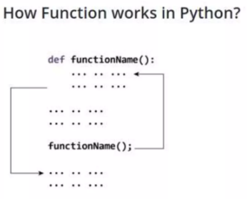
How a function works?
A function or routine is created or defined using a function name.
A routine/function can be invoked (called) as many times as needed in a given program.
When a routine terminates, execution automatically returns to the point from which it was called.

Slide 9
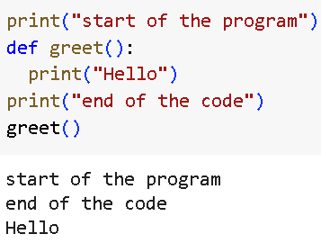
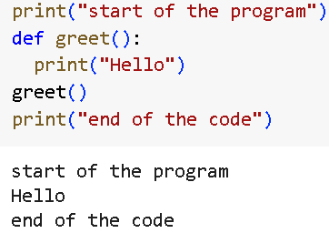
Note:
In function definition it is important that the block of code is indented.

Slide 10
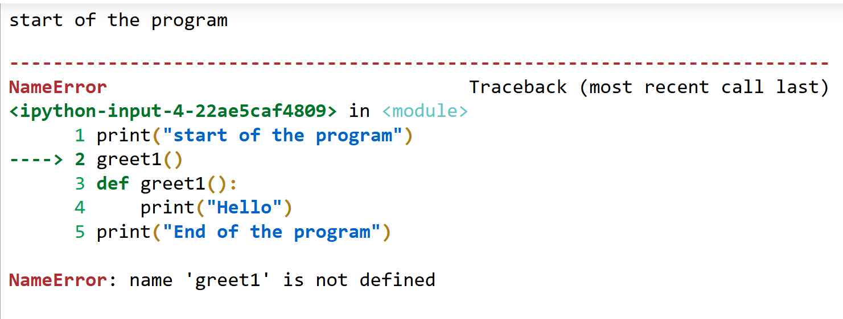
Note:
Function should be defined before the function call. Else it produces “name error”.
print("start of the program")
greet1()
def greet1():
print("Hello")
print("End of the program")

Slide 11
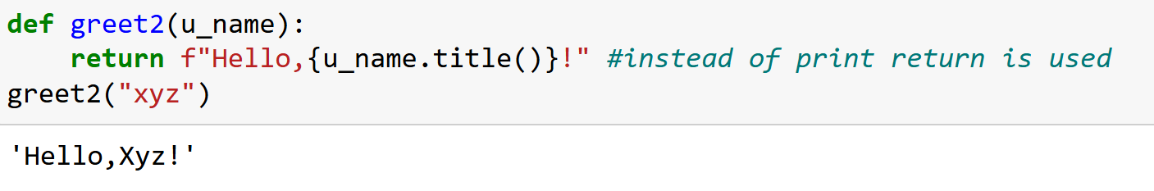
Parameter
A parameter is a variable listed inside the parentheses in the function definition.
It acts as a placeholder for the value that will be passed when the function is called.
Parameters define what kind of input the function expects.

Slide 12
arguments
An argument is the actual value passed to the function when it is called.
Arguments are the real values that replace the parameters when the function executes.
Arguments are specified after the function name, inside the parentheses.
You can add as many arguments as you want, just separate them with a comma.

Slide 13
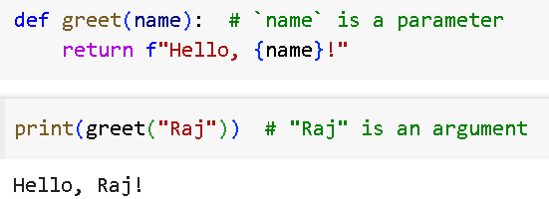

Slide 14
Practice
Write a function called favorite_book() that accepts one parameter, title. The function should print a message, such as One of my favorite books is Alice In Wonderland. Call the function, making sure to include a book title as an argument in the function call.

Slide 15
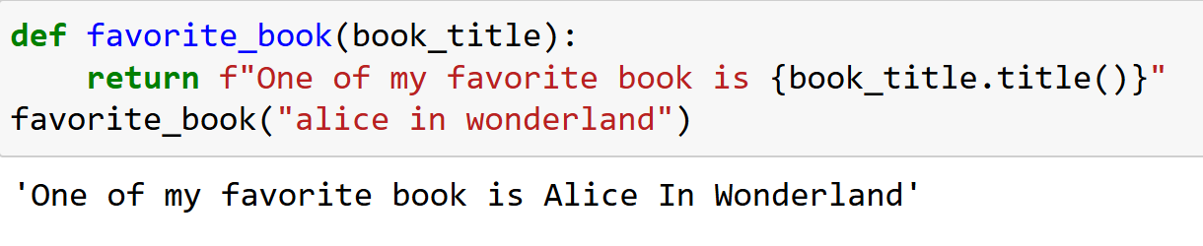

Slide 16
Parameter
>>> def greet(lang):
if lang == 'es’:
print('Hola’)
elif lang == 'fr’:
print('Bonjour’)
else:
print('Hello')
>>> greet('en')
Hello
>>> greet('es')
Hola
>>> greet('fr')
Bonjour
>>>
Argument

Slide 17
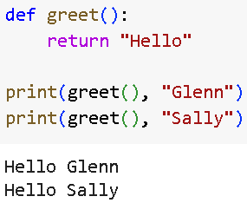
Return Values
Often a function will take its arguments, do some computation, and return a value to be used as the value of the function call in the calling expression.
The return keyword is used for this.

Slide 18
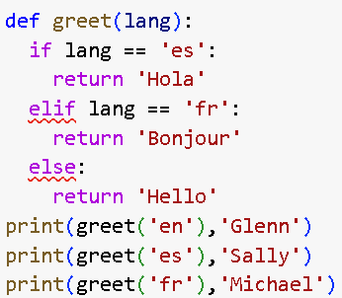


Slide 19
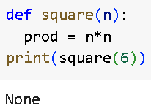
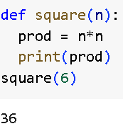
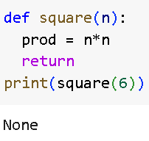
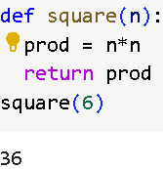
INCORRECT
CORRECT
INCORRECT
CORRECT

Slide 20
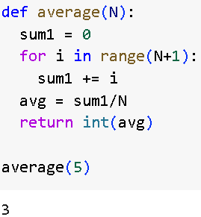
Example 1-one argument/parameter
Write a program to fins sum of N values:
PARAMETER
ARGUMENT

Slide 21
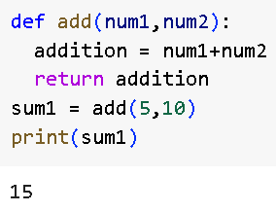
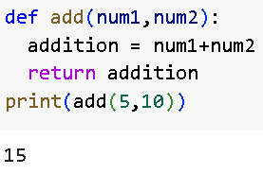
Example 2-two argument/parameter
Write a program to add two numbers using functions.

Slide 22
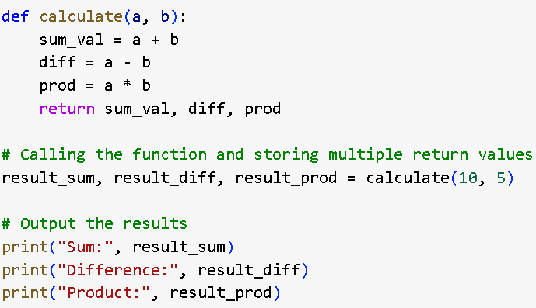

Example-3 – Multiple return values
OUTPUT

Slide 23
Arguments
You can call a function by using the following types of formal arguments i.e., different methods of passing the argument:
Required arguments/Positional argument (matched from left to right)
Keyword arguments (matched by argument name)
Default arguments (specify values for arguments that aren’t passed)

Slide 24
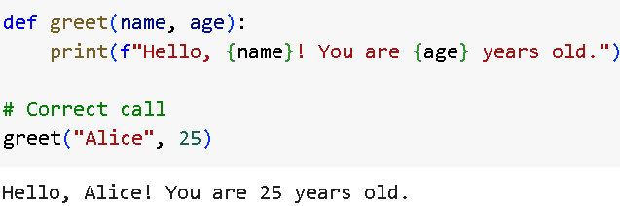
Required/Postional arguments
These are the arguments that must be passed in the correct order and number when calling a function.
If any required argument is missing, Python will throw an error.

Slide 25
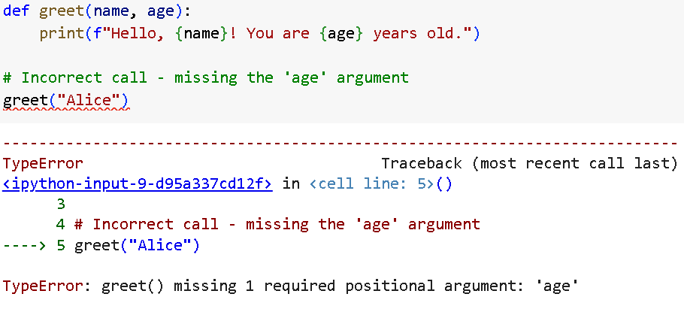

Slide 26
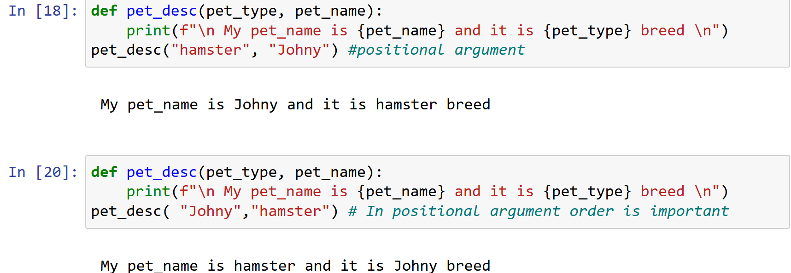

Slide 27
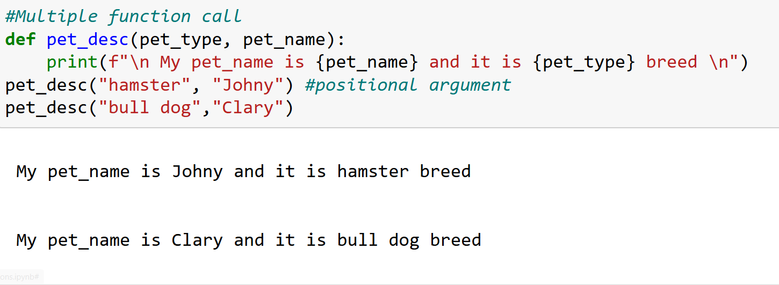

Slide 28
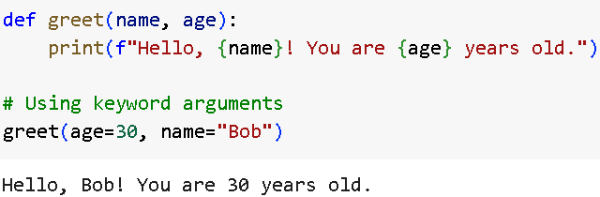
Keyword Arguments
These arguments allow you to specify the value of parameters by their name.
This improves code readability and lets you pass arguments in any order.

Slide 29
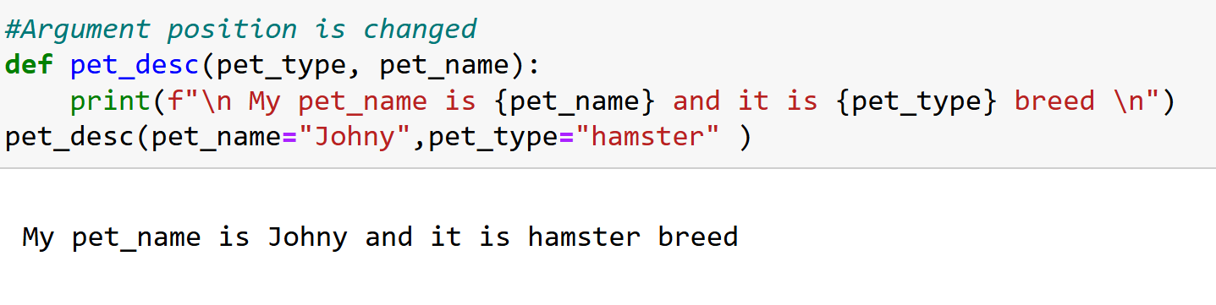

Slide 30
Default Arguments
These arguments take on a default value if no argument value is provided.
This is useful for providing default behavior while still allowing flexibility.

Slide 31
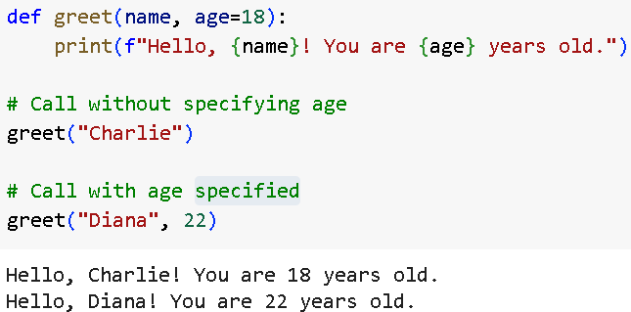

Slide 32
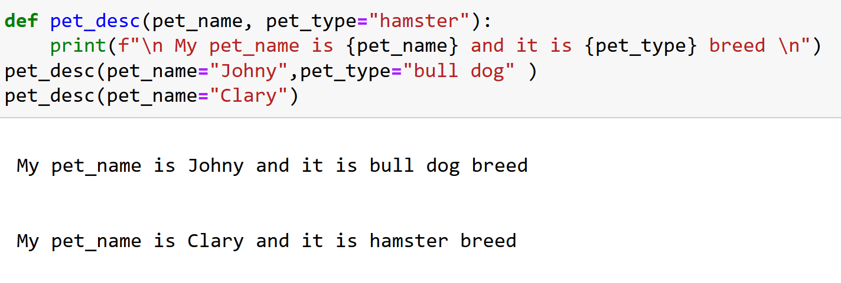

Slide 33
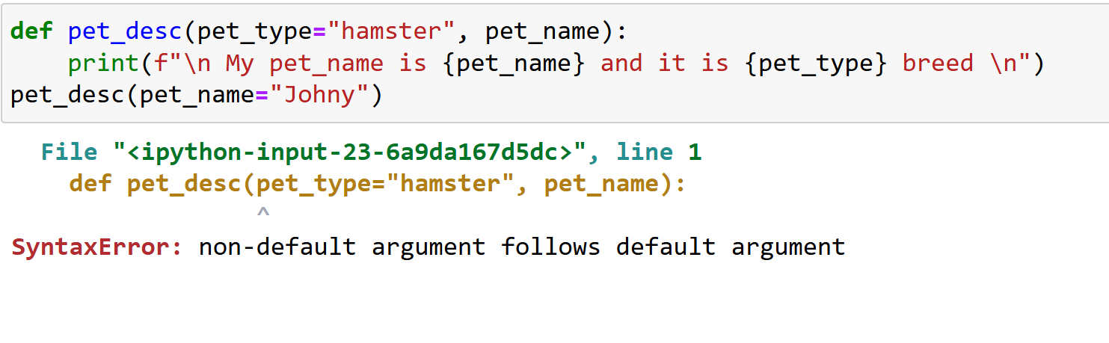

Slide 34
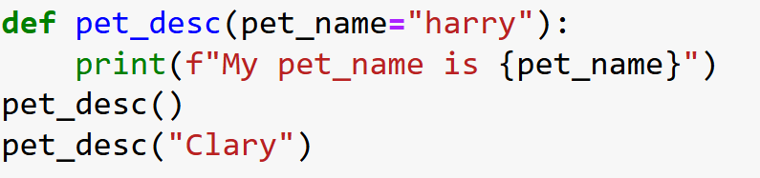
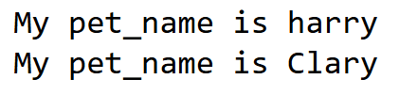

Slide 35
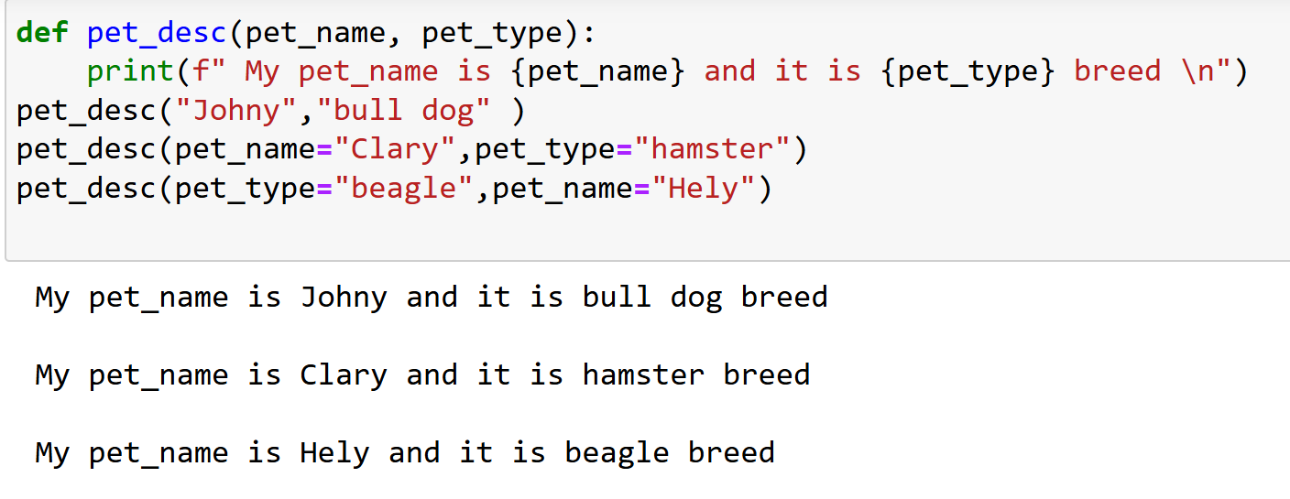
Equivalent Function Calls
Because positional arguments, keyword arguments, and default values can all be used together, often you’ll have several equivalent ways to call a function.

Slide 36
Variable-Length Arguments
Arbitrary Positional Arguments (*args): Allows a function to accept any number of positional arguments.
Arbitrary Keyword Arguments (**kwargs): Allows a function to accept any number of keyword arguments.
Note: Varargs collecting: collect arbitrarily many positional or keyword arguments

Slide 37
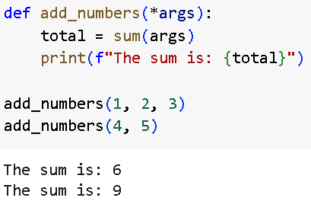

Slide 38
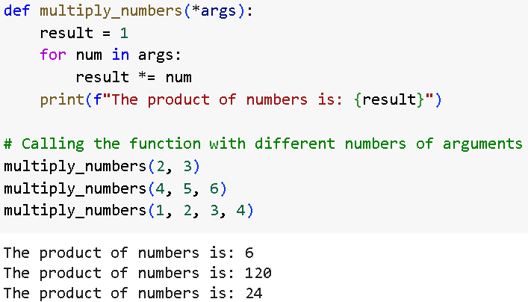

Slide 39
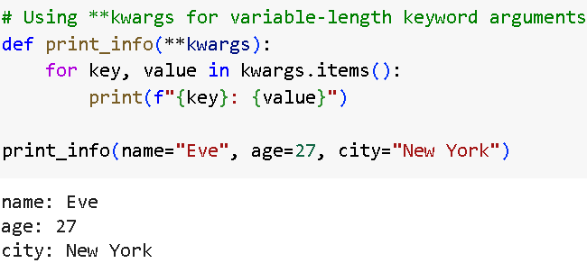

Slide 40
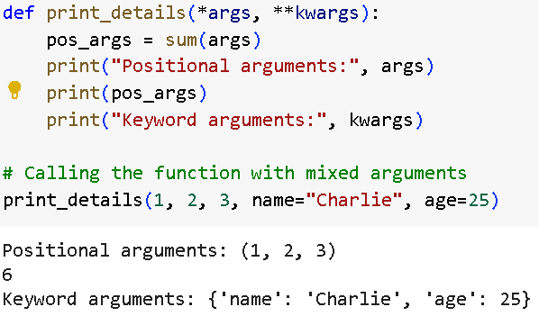

Slide 41
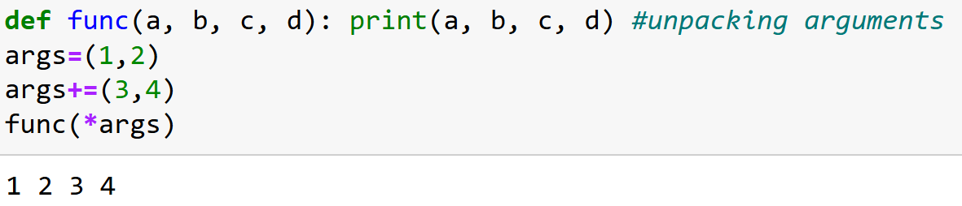
Unpacking of arguments

Slide 42
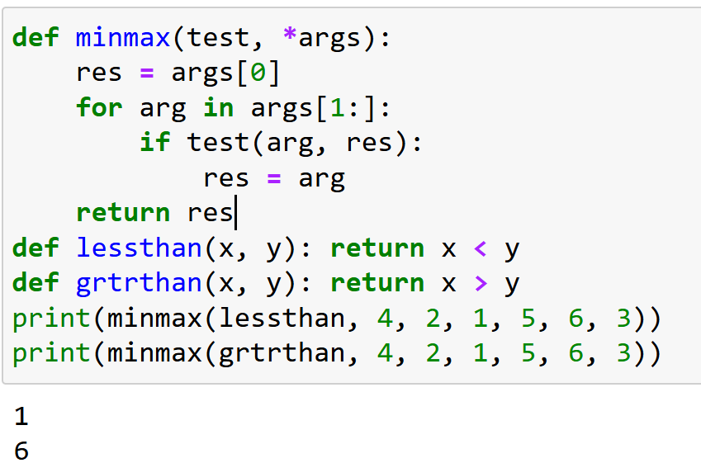
Nested function

Slide 43
Order of arguments
The steps that Python internally carries out to match arguments before assignment can roughly be described as follows:
1. Assign non keyword arguments by position.
2. Assign keyword arguments by matching names.
3. Assign extra nonkeyword arguments to *name tuple.
4. Assign extra keyword arguments to **name dictionary.
5. Assign default values to unassigned arguments in header.

Slide 44
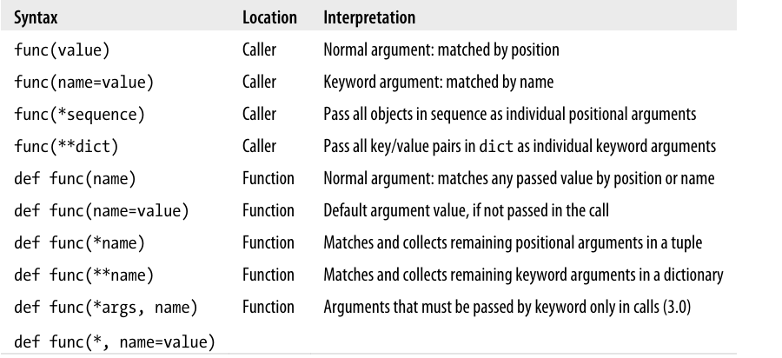

Slide 45
Practice
Write a function called describe_city() that accepts the name of a city and its country. The function should print a simple sentence, such as Reykjavik is in Iceland. Give the parameter for the country a default value. Call your function for three different cities, at least one of which is not in the default country.
Write a function called make_shirt() that accepts a size and the text of a message that should be printed on the shirt. The function should print a sentence summarizing the size of the shirt and the message printed on it.
Call the function once using positional arguments to make a shirt. Call the function a second time using keyword arguments.

Slide 46
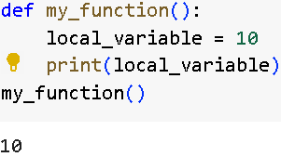
Scope of variables
1. Local Scope
Variables declared inside a function are local to that function and cannot be accessed outside it.

Slide 47
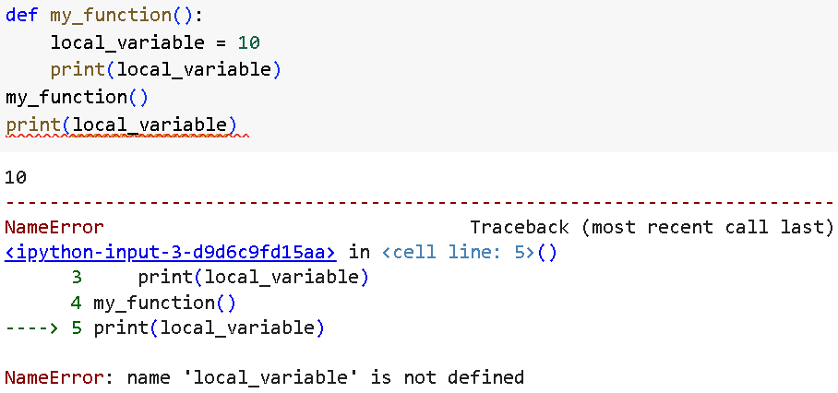

Slide 48
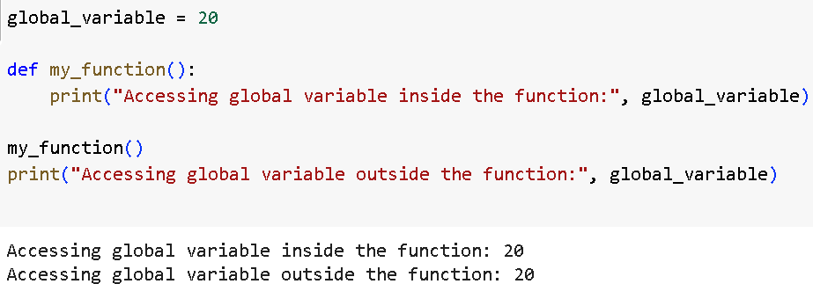
Scope of variables
2. Global Scope
Variables declared outside any function have global scope and are accessible throughout the program.

Slide 49
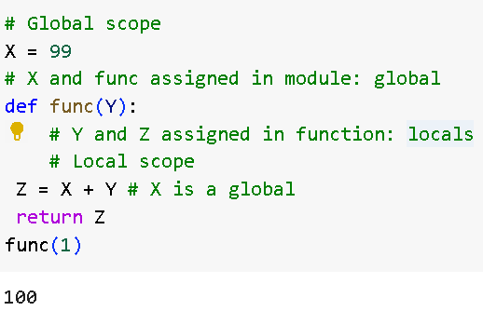

Slide 50
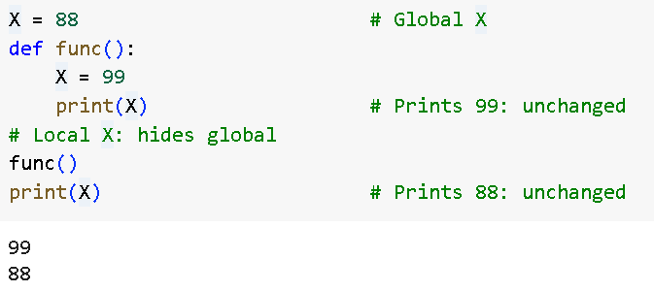

Slide 51
Scope of variables
3. Enclosing Scope (Nonlocal Scope)
When you have nested functions, the inner function can access variables from the outer function’s scope.
These variables are said to be in the enclosing scope.

Slide 52
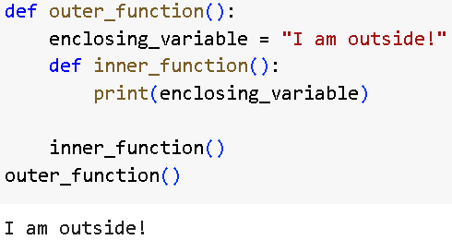

Slide 53
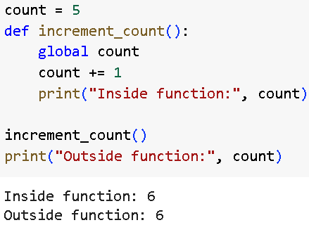
4. Modifying Global Variables
If you want to modify a global variable inside a function, you need to use the global keyword.

Slide 54
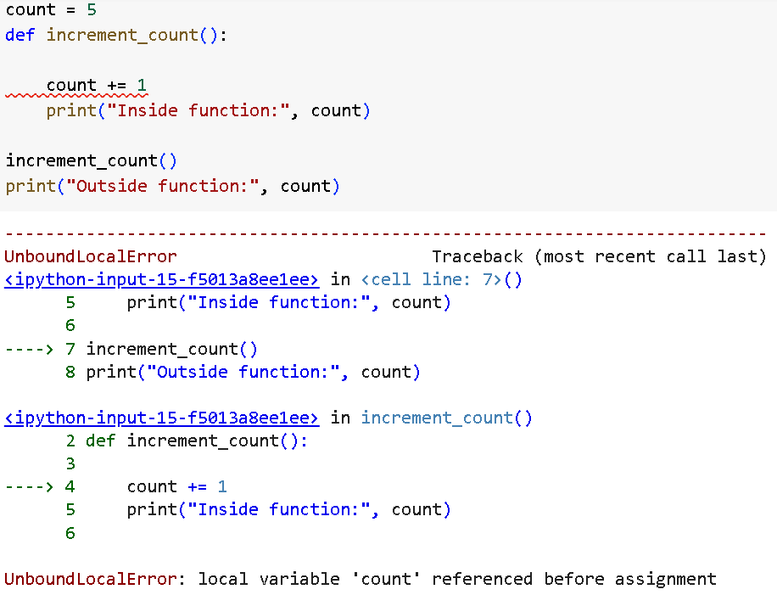

Slide 55
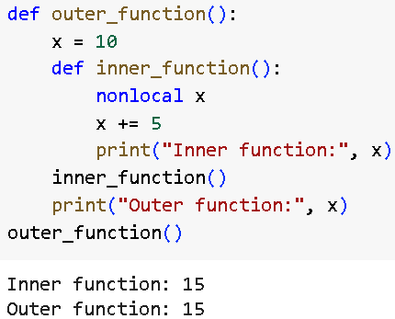
5.Using nonlocal in Nested Functions
If you want to modify a variable in the enclosing scope (not the global one), use the nonlocal keyword.

Slide 56
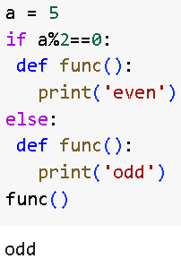
Function definition in selection statement Example

Slide 57
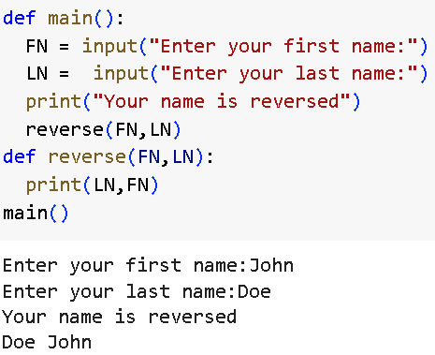
Passing two string arguments to a function

Slide 58
Recursive function
Recursion is a common mathematical and programming concept.
It means that a function calls itself.
This has the benefit of meaning that you can loop through data to reach a result.
The developer should be very careful with recursion as it can be quite easy to slip into writing a function which never terminates, or one that uses excess amounts of memory or processor power.
Recursion can of two types:
Direct Recursion
Indirect Recursion

Slide 59
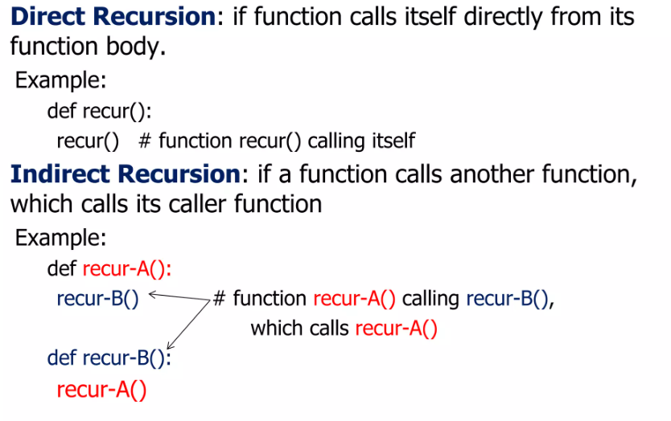

Slide 60
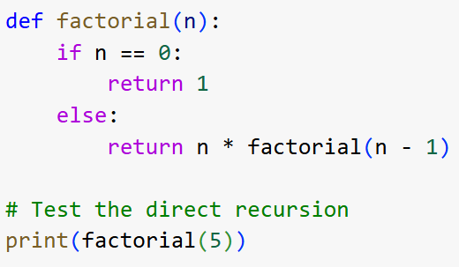
Example: Calculating Factorial with Direct Recursion
Base case
Recursive case

Slide 61
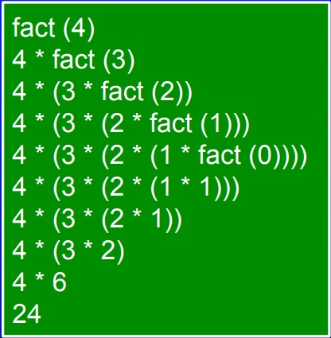

Slide 62


Slide 63


Slide 64

Example: Two Functions Alternating Calls (Even and Odd Check)

Slide 65
Lambda
Sometimes you need a simply arithmetic function
Its silly to write a method for it, but redundant not too
With lambda we can create quick simple functions
Facts
Lambda functions can only be comprised of a single expression
No loops, no calling other methods
Lambda functions can take any number of variables
Syntax:
lambda argument1, argument2,... argumentN :expression using argument

Slide 66




Slide 67


Slide 68
#Example 1
square_func = lambda x : x**2
square_func(4) #return: 16
#Example 2
close_enough = lambda x, y : abs(x – y) < 3
close_enough(2, 4) #return: True
#Example 3
def get_func(n) :
return lambda x : x * n + x % n
my_func = get_func(13)
my_func(4) #return: 56

Slide 69
Task
1. Write a Python function named square(num) that takes an argument num and returns the square of that number
2. Write a Python function named add_three_numbers(a,b,c) that takes three arguments and returns their sum. Use this function to find the sum of the numbers and print the result.
3. Write a Python function named area that takes the radius of a circle as an argument and returns the area of the circle. Use this function to find the area of a circle.

Slide 70

Task
4. Define a function rectangle_info that takes the length and width of a rectangle as positional arguments and has two keyword-only arguments: area and perimeter where you mention default value for area and parameter as False.
If area is True, the function returns the area of the rectangle;
if perimeter is True, it returns the perimeter.
If both or neither are specified, return both values as a tuple.

Slide 71


Slide 72

Task
5. Define a function manage_inventory that takes item as a required argument, quantity as an optional keyword argument with default value 1, and inventory as an optional list.
The function should add the item and quantity to the inventory list and return the updated list.

Slide 73


Slide 74
Task
6. Write a function to check which numbers in a list are perfect squares. Return a list of those perfect square numbers.

Slide 75


Slide 76


Slide 77
TAsk
7. Implement a program that calculates the median of numbers in a list.

Slide 78


Slide 79
Task
8. Write a program that takes a list of integers and returns the sum of elements that are at odd indices.
9. Write a function that takes a list and returns a dictionary where keys are elements and values are their frequencies.

Slide 80


Slide 81


Slide 82

10. Write a program that generates and prints a multiplication table (from 1 to N) using nested loops. The outer loop should iterate over the numbers, while the inner loop should calculate and print each product.

Slide 83


Slide 84
File handling

Slide 85
File format
Python treats files differently as text or binary and this is important.
Each line of code includes a sequence of characters, and they form a text file.
Each line of a file is terminated with a special character, called the EOL or End of Line characters like comma {,} or newline character.
It ends the current line and tells the interpreter a new one has begun. Let’s start with the reading and writing files.

Slide 86
Advantages
Versatility : File handling in Python allows you to perform a wide range of operations, such as creating, reading, writing, appending, renaming, and deleting files.
Flexibility : File handling in Python is highly flexible, as it allows you to work with different file types (e.g. text files, binary files, CSV files , etc.), and to perform different operations on files (e.g. read, write, append, etc.).
User – friendly : Python provides a user-friendly interface for file handling, making it easy to create, read, and manipulate files.
Cross-platform : Python file-handling functions work across different platforms (e.g. Windows, Mac, Linux), allowing for seamless integration and compatibility.

Slide 87
disadvatages
Error-prone: File handling operations in Python can be prone to errors, especially if the code is not carefully written or if there are issues with the file system (e.g. file permissions, file locks, etc.).
Security risks : File handling in Python can also pose security risks, especially if the program accepts user input that can be used to access or modify sensitive files on the system.
Complexity : File handling in Python can be complex, especially when working with more advanced file formats or operations. Careful attention must be paid to the code to ensure that files are handled properly and securely.
Performance : File handling operations in Python can be slower than other programming languages, especially when dealing with large files or performing complex operations.

Slide 88
Opening a File in Python
file = open("filename", "mode")
Where,
filename is the name of the file to open and
mode is the mode in which the file is opened
(e.g., 'r' for reading, 'w' for writing, 'a' for appending).

Slide 89
Modes and Description
r
Opens a file for reading only. The file pointer is placed at the beginning of the file. This is the default mode.
rb
Opens a file for reading only in binary format. The file pointer is placed at the beginning of the file. This is the default mode.
r+
Opens a file for both reading and writing. The file pointer placed at the beginning of the file.
rb+
Opens a file for both reading and writing in binary format. The file pointer placed at the beginning of the file.

Slide 90
Modes and Description
w
Opens a file for writing only. Overwrites the file if the file exists. If the file does not exist, creates a new file for writing.
b
Opens the file in binary mode
t
Opens the file in text mode (default)
+
open file for updating (reading and writing)

Slide 91
Modes and Description
wb
Opens a file for writing only in binary format. Overwrites the file if the file exists. If the file does not exist, creates a new file for writing.
w+
Opens a file for both writing and reading. Overwrites the existing file if the file exists. If the file does not exist, creates a new file for reading and writing.
a
Opens a file for appending. The file pointer is at the end of the file if the file exists. That is, the file is in the append mode. If the file does not exist, it creates a new file for writing.

Slide 92
Modes and Description
ab
Opens a file for appending in binary format. The file pointer is at the end of the file if the file exists. That is, the file is in the append mode. If the file does not exist, it creates a new file for writing.
a+
Opens a file for both appending and reading. The file pointer is at the end of the file if the file exists. The file opens in the append mode. If the file does not exist, it creates a new file for reading and writing.
ab+
Opens a file for both appending and reading in binary format. The file pointer is at the end of the file if the file exists. The file opens in the append mode. If the file does not exist, it creates a new file for reading and writing.

Slide 93
Modes and Description
x
open for exclusive creation, failing if the file already exists

Slide 94
Examole
# Opening a file in read mode
file = open("example.txt", "r")
# Opening a file in write mode
file = open("example.txt", "w")
# Opening a file in append mode
file = open("example.txt", "a")
# Opening a file in binary read mode
file = open("example.txt", "rb")

Slide 95
Reading a File in Python
Reading a file in Python involves opening the file in a mode that allows for reading, and then using various methods to extract the data from the file. Python provides several methods to read data from a file −
read() − Reads the entire file.
readline() − Reads one line at a time.
readlines − Reads all lines into a list.
Note:To read a file, you need to open it in read mode. The default mode for the open() function is read mode ('r'), but it's good practice to specify it explicitly.

Slide 96
Example
with open("example.txt", "r") as file:
content = file.read()
print(content)
Output: Hello
Welcome

Slide 97
Why “ with open”
Using with ensures that the file is automatically closed after the indented block is executed, even if an error occurs.
It automatically handles file closing, preventing resource leaks.
It makes the code more readable and less error-prone.

Slide 98
Without “ with open”
file = open("example.txt", "r") # Open the file in read mode
content = file.read() # Read the file's content
print(content) # Print the content
file.close() # Close the file

Slide 99
readline() method
readline() method to read one line at a time, making it memory efficient for reading large files line by line
with open("example.txt", "r") as file:
line = file.readline()
while line:
print(line, end='')
line = file.readline()

Slide 100
Using readlines() method
readlines() method is to read the entire file and splits it into a list where each element is a line.
with open("example.txt", "r") as file:
lines = file.readlines()
for line in lines:
print(line, end=‘’)
Output: Hello
Welcome

Slide 101
Writing to a File in Python
Writing to a file in Python involves opening the file in a mode that allows writing, and then using various methods to add content to the file.
To write data to a file, use the
write()
writelines() methods.
When opening a file in write mode ('w'), the file's existing content is erased.

Slide 102
Using the write() method
with open("foo.txt", "w") as file:
file.write("Hello, World!")
print ("Content added Successfully!!")
Output:
"Content added Successfully!!"

Slide 103
Using the writelines() method
the write lines () method takes a list of strings and writes each string to the file. It is useful for writing multiple lines at once
lines = ["First line\n", "Second line\n", "Third line\n"]
with open("example.txt", "w") as file:
file.writelines(lines)
print ("Content added Successfully!!")

Slide 104

appending to a File in Python

Slide 105
Closing a File in Python
We can close a file in Python using the close() method.
Closing a file is an essential step in file handling to ensure that all resources used by the file are properly released.
It is important to close files after operations are completed to prevent data loss and free up system resources.

Slide 106


Example

Slide 107
The tell() and seek() methods in Python are used to manage the file cursor, allowing you to get the current position or move the cursor to a different position in a file.
tell() Method
The tell() method returns the current position of the file cursor (in bytes) from the beginning of the file.
This is useful to track where you are while reading or writing a file.

Slide 108
seek() Method
The seek() method moves the file cursor to a specified location.
It takes two parameters:
offset: The number of bytes to move the cursor.
whence (optional): Specifies the reference point for offset. It can be:
0 (default) - Start of the file.
1 - Current position of the file cursor.
2 - End of the file.

Slide 109


